Slide 1
Colorado Department of State
Judd Choate, State Election Director
2020 General Election Recap
March 11, 2021

Slide 2
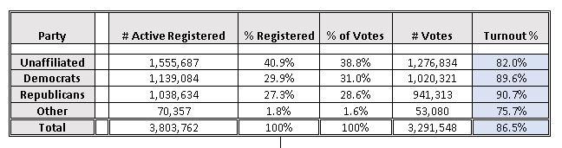
2020 General Election
Colorado Turnout By Party

Slide 3
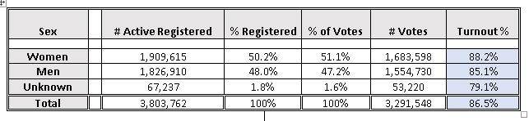
2020 General Election
Colorado Turnout By Sex

Slide 4
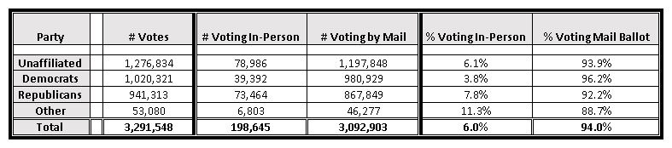
2020 General Election
Colorado In-Person/Mail Turnout

Slide 5
2020 General Election
Active Voter Turnout by Age Categories

Slide 6
2020 General Election Active Voter Turnout in Colorado’s 11 Most Populous Counties

Slide 7
Change in Active Registration Party Vote Percentage 2014-2020

Slide 8
2020 General Election Wins by Party

Slide 9
2020 General Election Ballot Rejection Percentages by Age of Voter

Slide 10
2018 General Election Ballot Rejection Percentage by Age of Voter

Slide 11
Comparing Colorado to the Nation

Slide 12
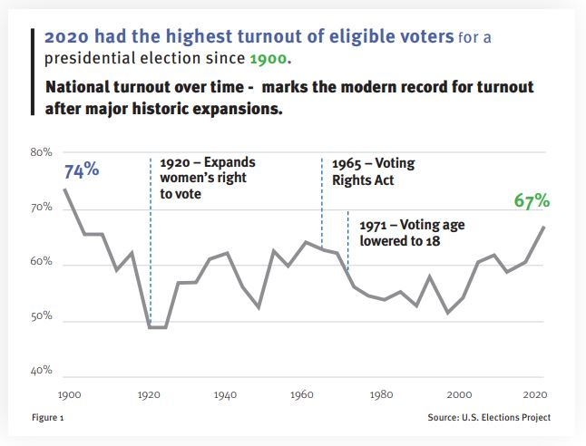
National VEP Turnout 1900-2020

Slide 13
Colorado v. National Turnout
2000-2020

Slide 14
Top States VEP Turnout
2000-2020

Slide 15
2020 General Election
Voting Eligible Population Turnout by State

Slide 16
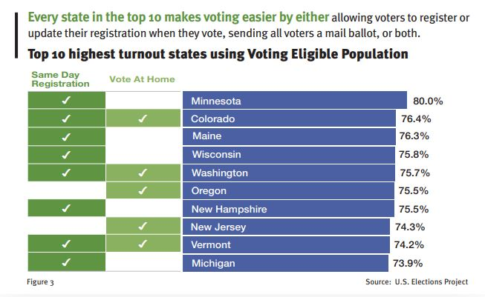
State Policies for Top 10 VEP States

Slide 17
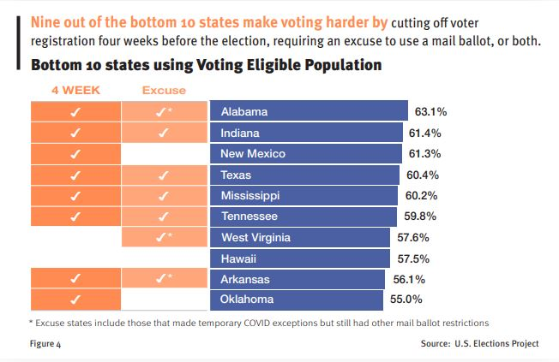
State Policies for Bottom 10 VEP States

Slide 18
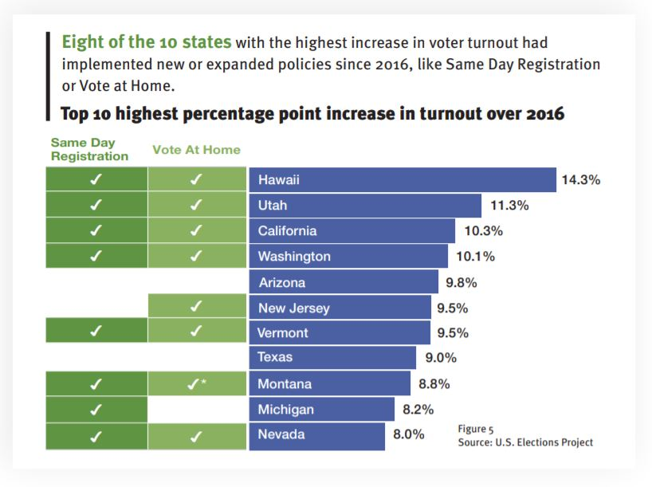
State Policies for Top 10 Increased
Turnout States

Slide 19
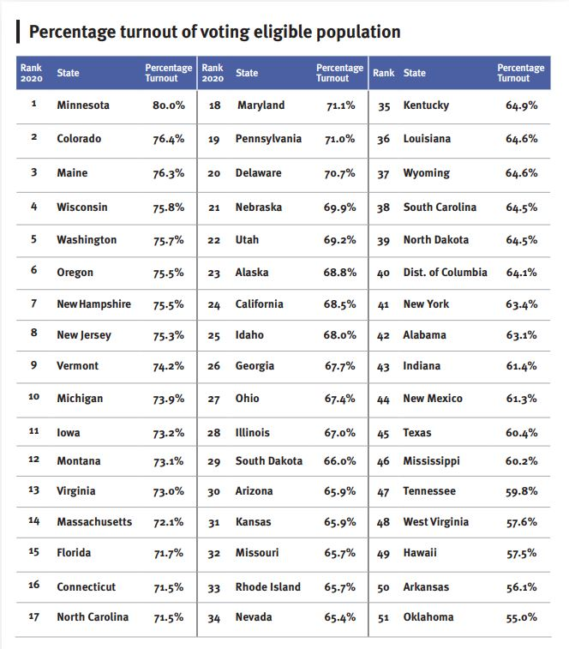

Slide 20
The Expansion of
Early Voting and Vote at Home

Slide 21
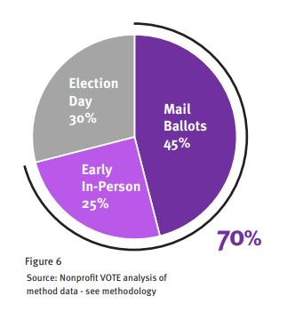
Percentage Voting Prior to Election Day

Slide 22
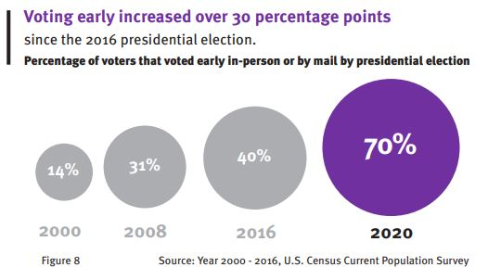
Early Voting Percentage 2000-2020

Slide 23
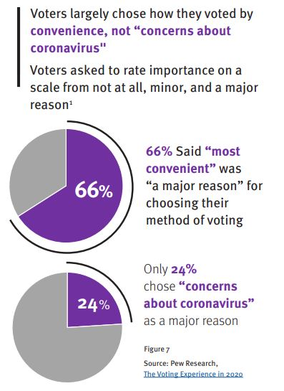
Why Voters Chose to Vote Early in 2020

Slide 24
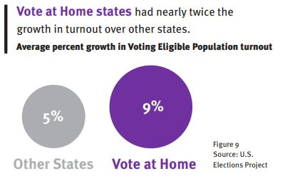
Early Voting Effect on 2020 VEP Turnout

Slide 25
The Expansion of
Vote By Mail

Slide 26
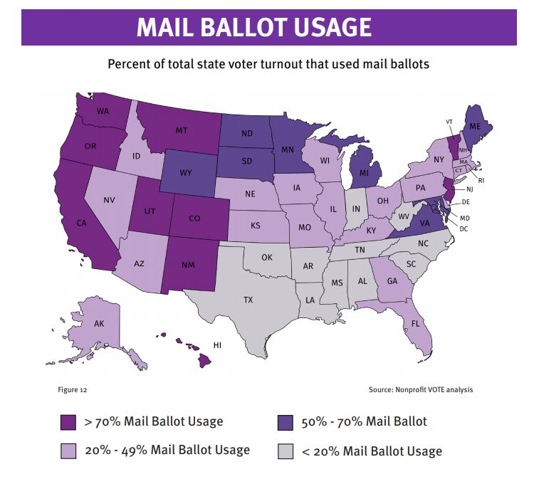

Slide 27
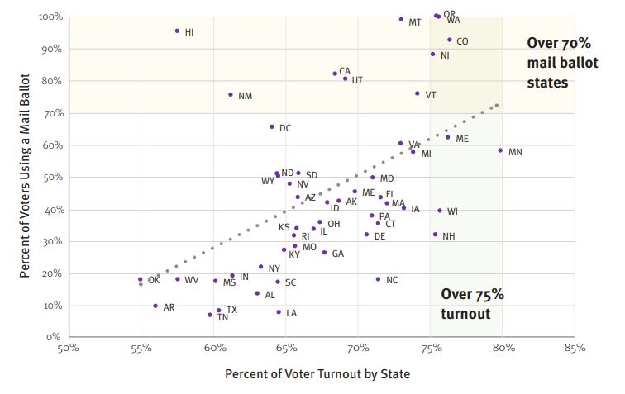
2020 General Election Percentage Mail Ballot Relationship to VEP Turnout

Slide 28
Colorado Department of State
Judd Choate, State Election Director
judd.choate@sos.state.co.us
303-869-4927

